Slide 1

CONTROL FLOW CONSTRUCTS AND FLOWCHARTS
BY KARTHIK SUBRAMANIAN

Slide 2
Conditional constructs
If/ else if /....../else
Executes by sequentially evaluating each condition until any of the condition is true
If the condition is true it executes the statements in the block and comes out of the if ladder

Slide 3
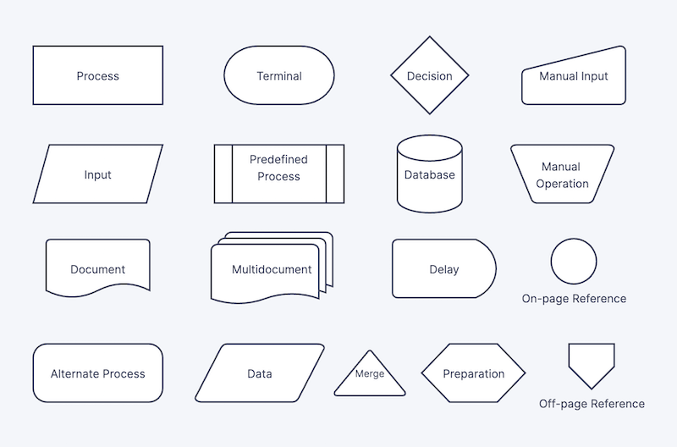
Flowchart symbols

Slide 4
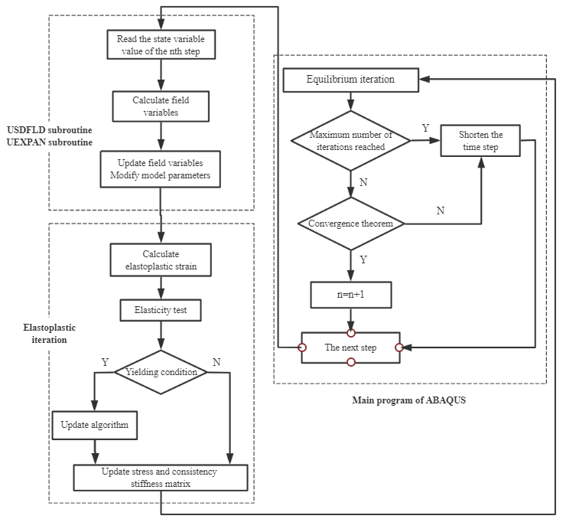
Flowchart for subroutines

Slide 5
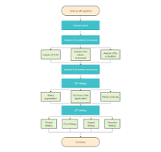
Flowchart for concurrency

Slide 6
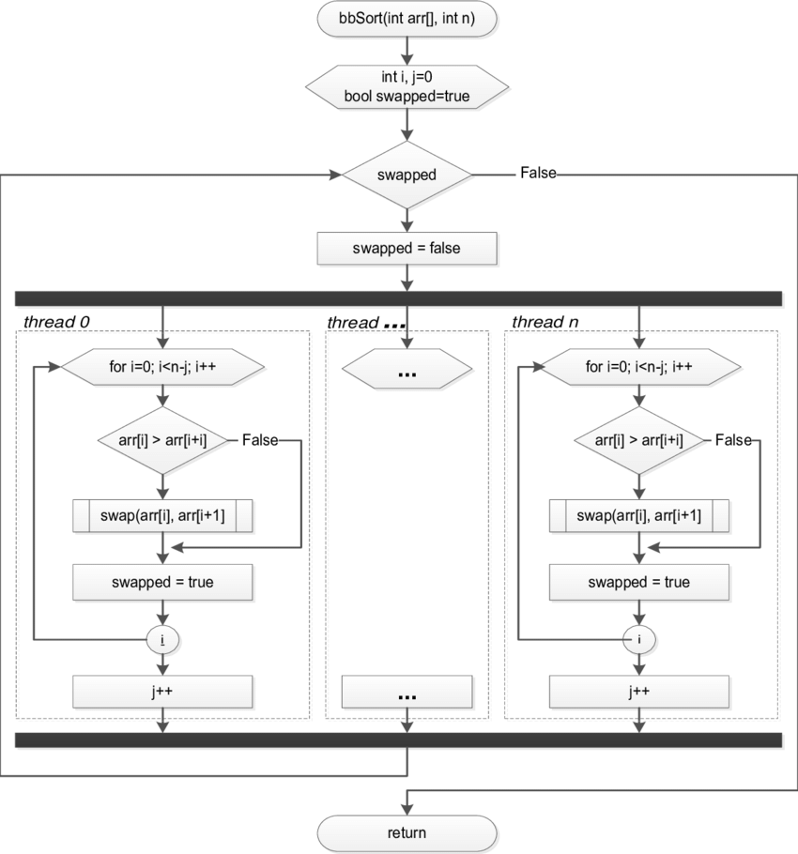
Flowchart for Concurrency

Slide 7
Logical Operators
AND – Returns true only if all the operands are true, otherwise returns false
OR – Returns false only when all the operands are false, returns true otherwise
NOT- Negates the truth value of the operand
XOR- Returns true whem the operands have different truth value, otherwise returns false.

Slide 8
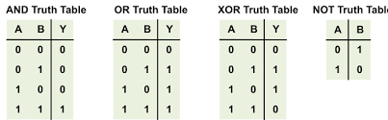
Truth Table

Slide 9
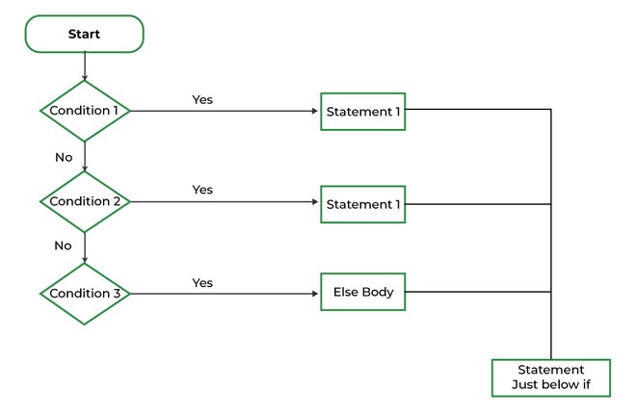
C If /else if/ else flowchart

Slide 10
C: If /else if/else
Determine the grade of a student based on their score. If the score is above 90, it's an 'A'. If the score is between 80 and 90, check if it's above 85 for an 'A-' or else 'B+'. Below 80, if it's above 70, it's a 'C', otherwise, it's a 'D’.

Slide 11
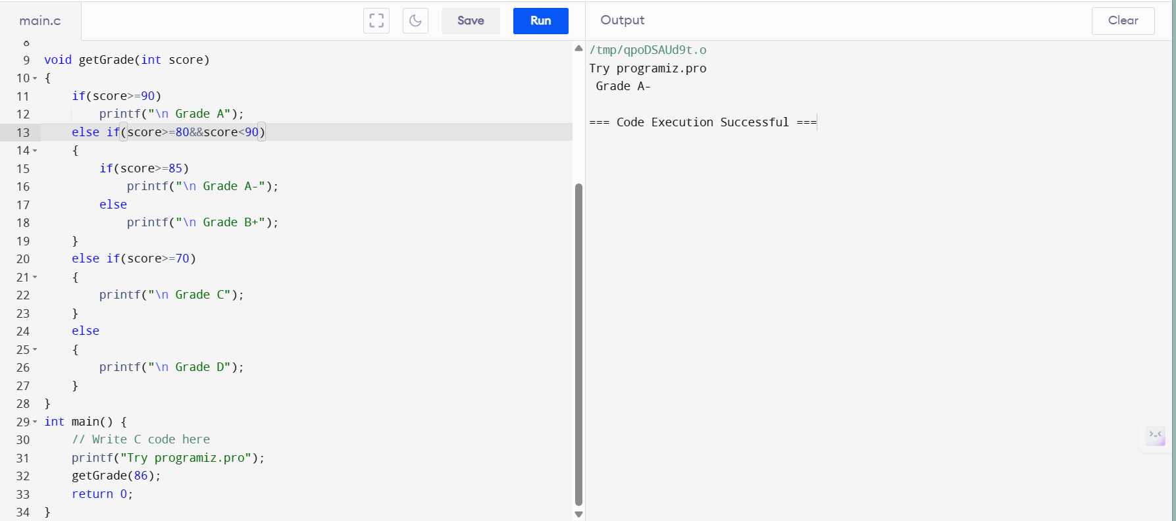
C: If/else if/else

Slide 12
C: switch-case
Switch Statement
Instead of writing many if..else statements, you can use the switch statement.
The switch statement selects one of many code blocks to be executed, by comparing the value with the target in each case block.

Slide 13
C switch case
This is how it works:
The switch expression is evaluated once
The value of the expression is compared with the values of each case
If there is a match, the associated block of code is executed
The break statement breaks out of the switch block and stops the execution
The default statement is optional, and specifies some code to run if there is no case match

Slide 14
C: switch case
Syntax
switch (expression) {
case x:
// code block
break;
case y:
// code block
break;
default:
// code block
}

Slide 15
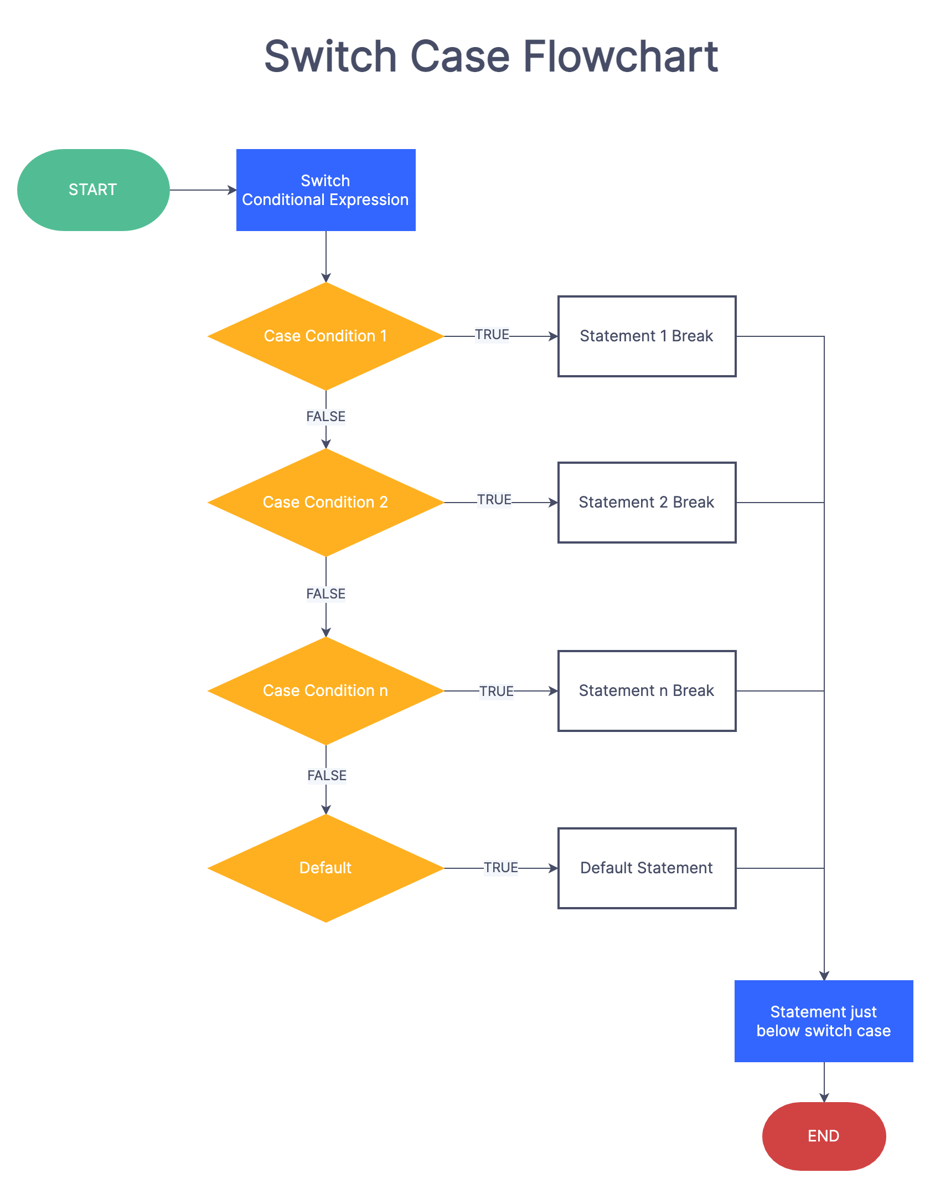
C switch case flowchart

Slide 16
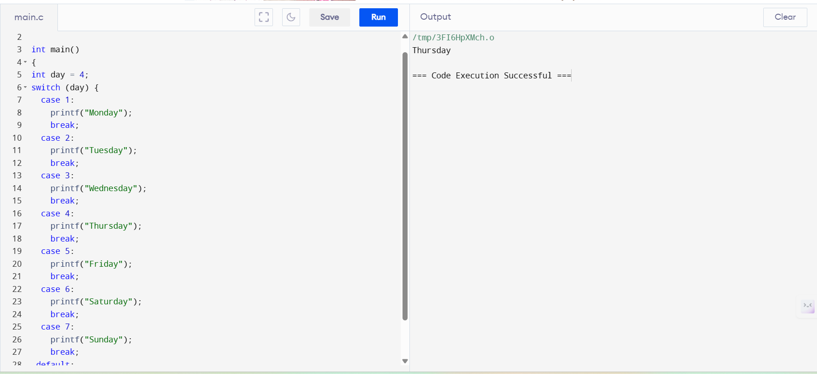
C: switch case example

Slide 17
C: loops
Loops are broadly classified into two types:
1. Entry controlled loops
In this kind of loop, the condition is checked before executing the loop's body. So, if the condition is never true, it won't execute even once. For example, for and while loop.
2. Exit controlled loops
In this kind of loop, the condition is checked after the loop's body is executed, i.e., in the end. Hence, even if the condition is not fulfilled, this loop will execute one time. The do-while loop is an example of exit controlled loop.

Slide 18
C: while loop
The while Loop is an entry-controlled loop in C programming language. This loop can be used to iterate a part of code while the given condition remains true.
Syntax
The while loop syntax is as follows:
while (test expression)
{
// body consisting of multiple statements
}

Slide 19
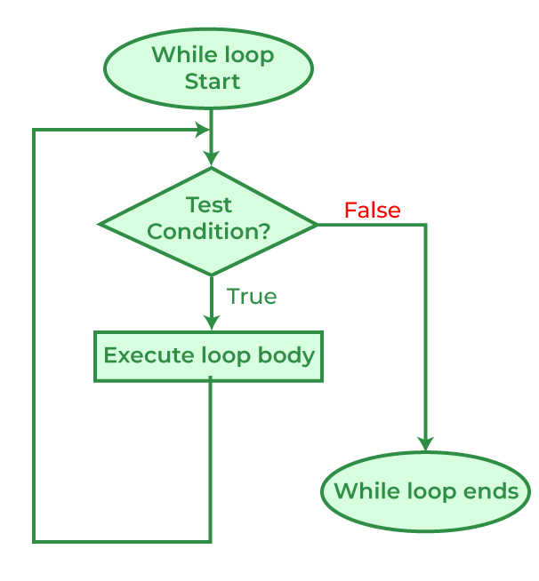
C: while loops Flowchart

Slide 20
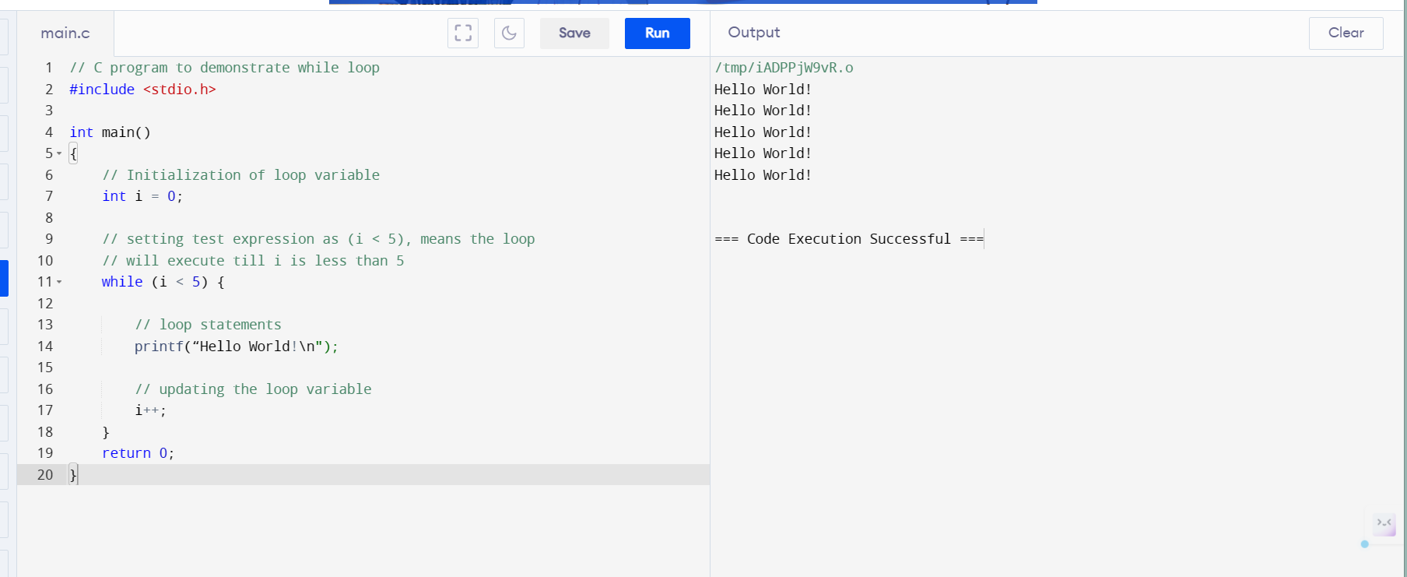
C : while loops

Slide 21
C: for loops
for Loop in C
The for loop in C Language provides a functionality/feature to repeat a set of statements a defined number of times. The for loop is in itself a form of an entry-controlled loop.
Unlike the while loop and do…while loop, the for loop contains the initialization, condition, and updating statements as part of its syntax. It is mainly used to traverse arrays, vectors, and other data structures.
Syntax of for Loop
for(initialization; check/test expression; updation)
{
// body consisting of multiple statements
}

Slide 22
C: for loops
Initialization: This step initializes a loop control variable with an initial value that helps to progress the loop or helps in checking the condition. It acts as the index value when iterating an array or string.
Check/Test Condition: This step of the for loop defines the condition that determines whether the loop should continue executing or not. The condition is checked before each iteration and if it is true then the iteration of the loop continues otherwise the loop is terminated.
Body: It is the set of statements i.e. variables, functions, etc that is executed repeatedly till the condition is true. It is enclosed within curly braces { }.
Updation: This specifies how the loop control variable should be updated after each iteration of the loop. Generally, it is the incrementation (variable++) or decrementation (variable–) of the loop control variable.

Slide 23
C: working of for loop
How for Loop Works?
The working of for loop is mentioned below:
Step 1: Initialization is the basic step of for loop this step occurs only once during the start of the loop. During Initialization, variables are declared, or already existing variables are assigned some value.
Step 2: During the Second Step condition statements are checked and only if the condition is the satisfied loop we can further process otherwise loop is broken.
Step 3: All the statements inside the loop are executed.
Step 4: Updating the values of variables has been done as defined in the loop.
Continue to Step 2 till the loop breaks.

Slide 24
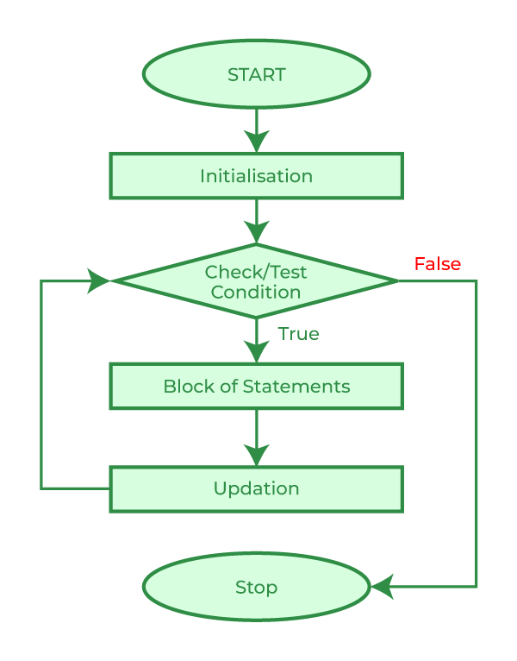
C : for loop flowchart

Slide 25
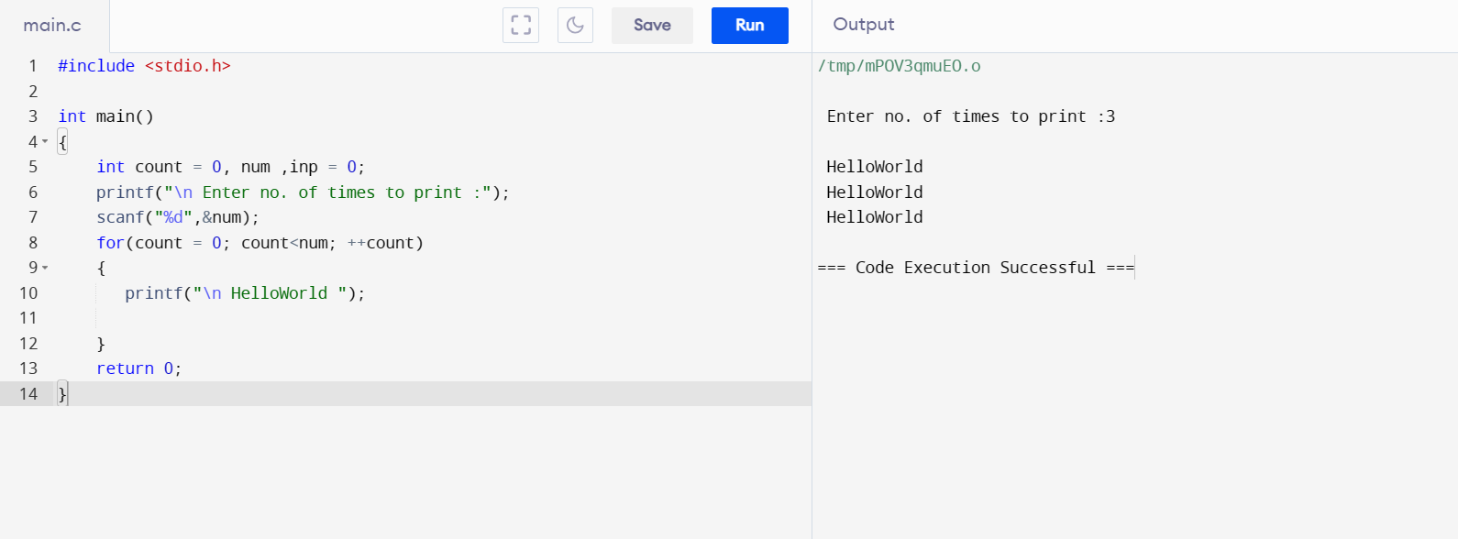
C: for loop example

Slide 26
C : do while loop
The do…while in C is a loop statement used to repeat some part of the code till the given condition is fulfilled. It is a form of an exit-controlled or post-tested loop where the test condition is checked after executing the body of the loop. Due to this, the statements in the do…while loop will always be executed at least once no matter what the condition is.
Syntax of do…while Loop in C
do {
// body of do-while loop
} while (condition);

Slide 27
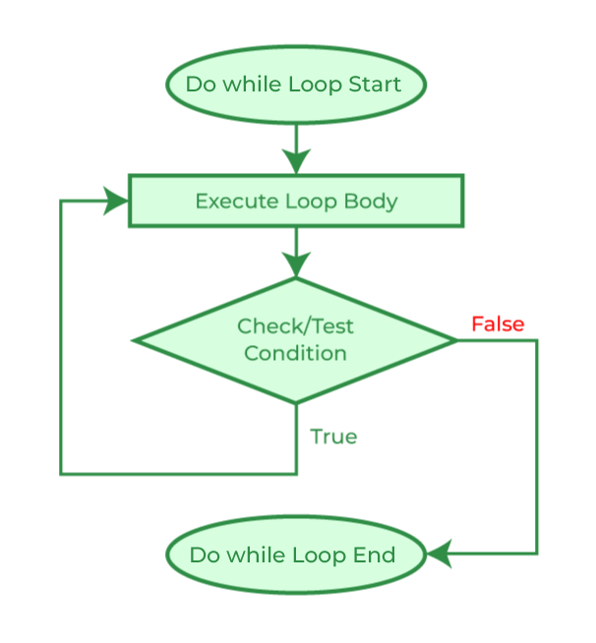
C : do while loop - flowchart

Slide 28
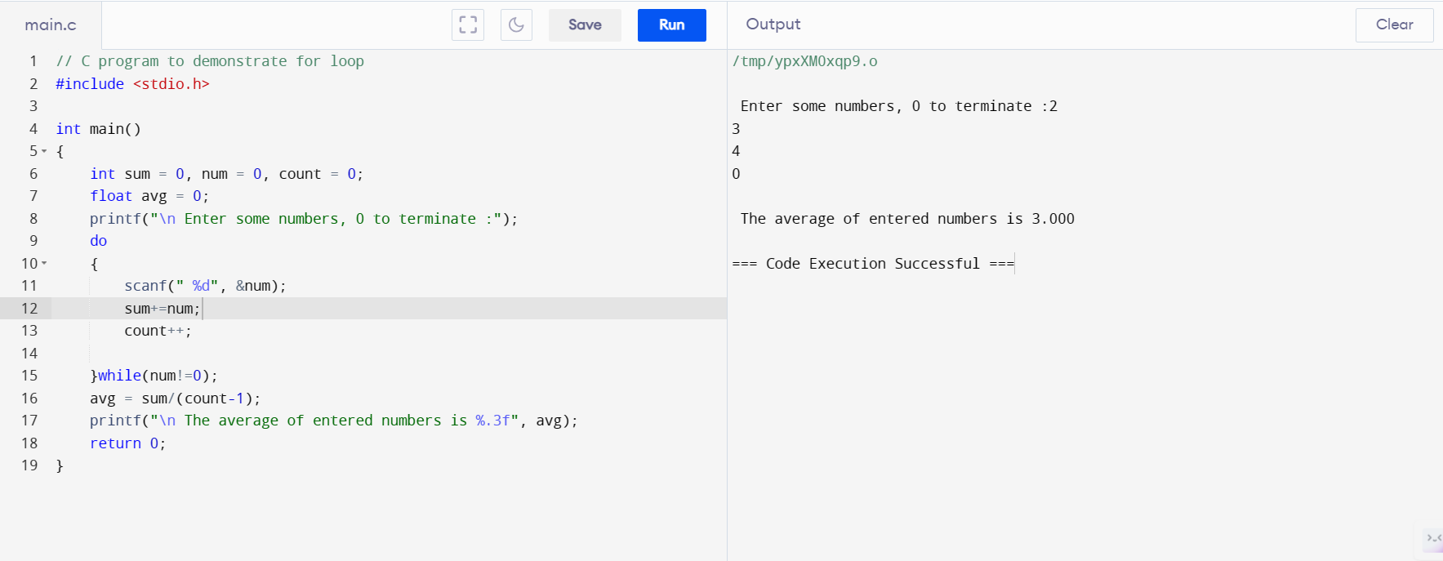
C do while loop example

Slide 29
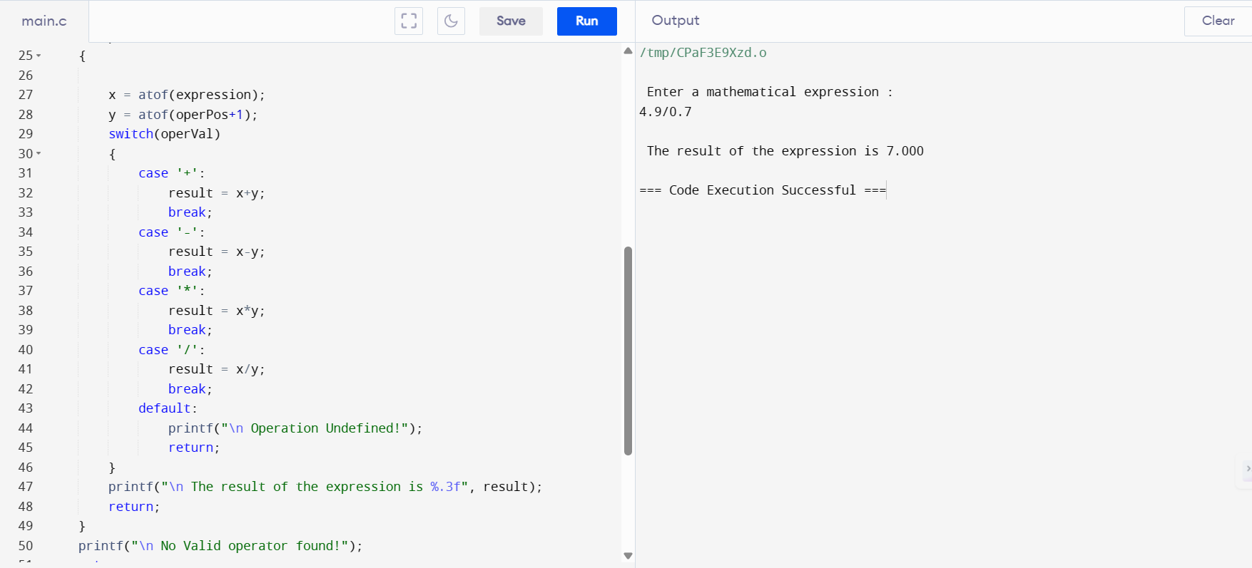
C: using while and switch case

Slide 30
Calculator program - flowchart
Start
Input string expression
Check for occurrence of operator (*,/,+, -) in expression and store in char pointer pos
N
Not a valid expression
Y
x = atof(string)
y = atof(pos+1)

Slide 31
Is operator = ‘*’
result = x*y
Y
N
Is operator = ‘/’
result = x/y
Y
N
Is operator = ‘+’
result = x+y
Y
Print result
N
Is operator = ‘-’
Y
result = x-y
Stop

